Slide 1

Manufacturing & Wholesale Business
Inter your starting sentence here.
www.samplesite.com

Slide 2

Table of Contents
01
Business Overview
02
Market Analysis
03
Sales and Marketing Plan
04
Management Plan
05
Operating Plan
06
Financial Plan

Slide 3

Business Overview
If you’re planning to start a manufacturing, fabrication, or production business you’ll need a business plan to do it. To help you get started, check out our library of sample plans to be sure you’re covering everything from sourcing your raw materials to budgeting for plant and equipment.
If you’re planning to start a manufacturing, fabrication, or production business you’ll need a business plan to do it. To help you get started, check out our library of sample plans to be sure you’re covering everything from sourcing your raw materials to budgeting for plant and equipment.

Slide 4



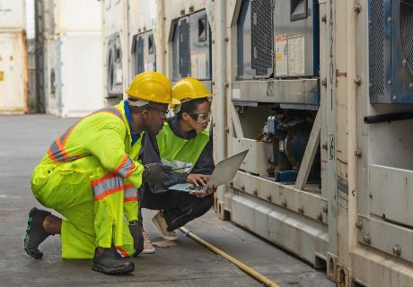
If you’re planning to start a manufacturing, fabrication, or production business you’ll need a business plan to do it. To help you get started,
check out our library of sample plans to be sure you’re covering everything from sourcing your raw materials to budgeting for plant and equipment.
If you’re planning to start a manufacturing, fabrication, or production business you’ll need a business plan to do it. To help you get started,
check out our library of sample plans to be sure you’re covering everything from sourcing your raw materials to budgeting for plant and equipment.

Slide 5
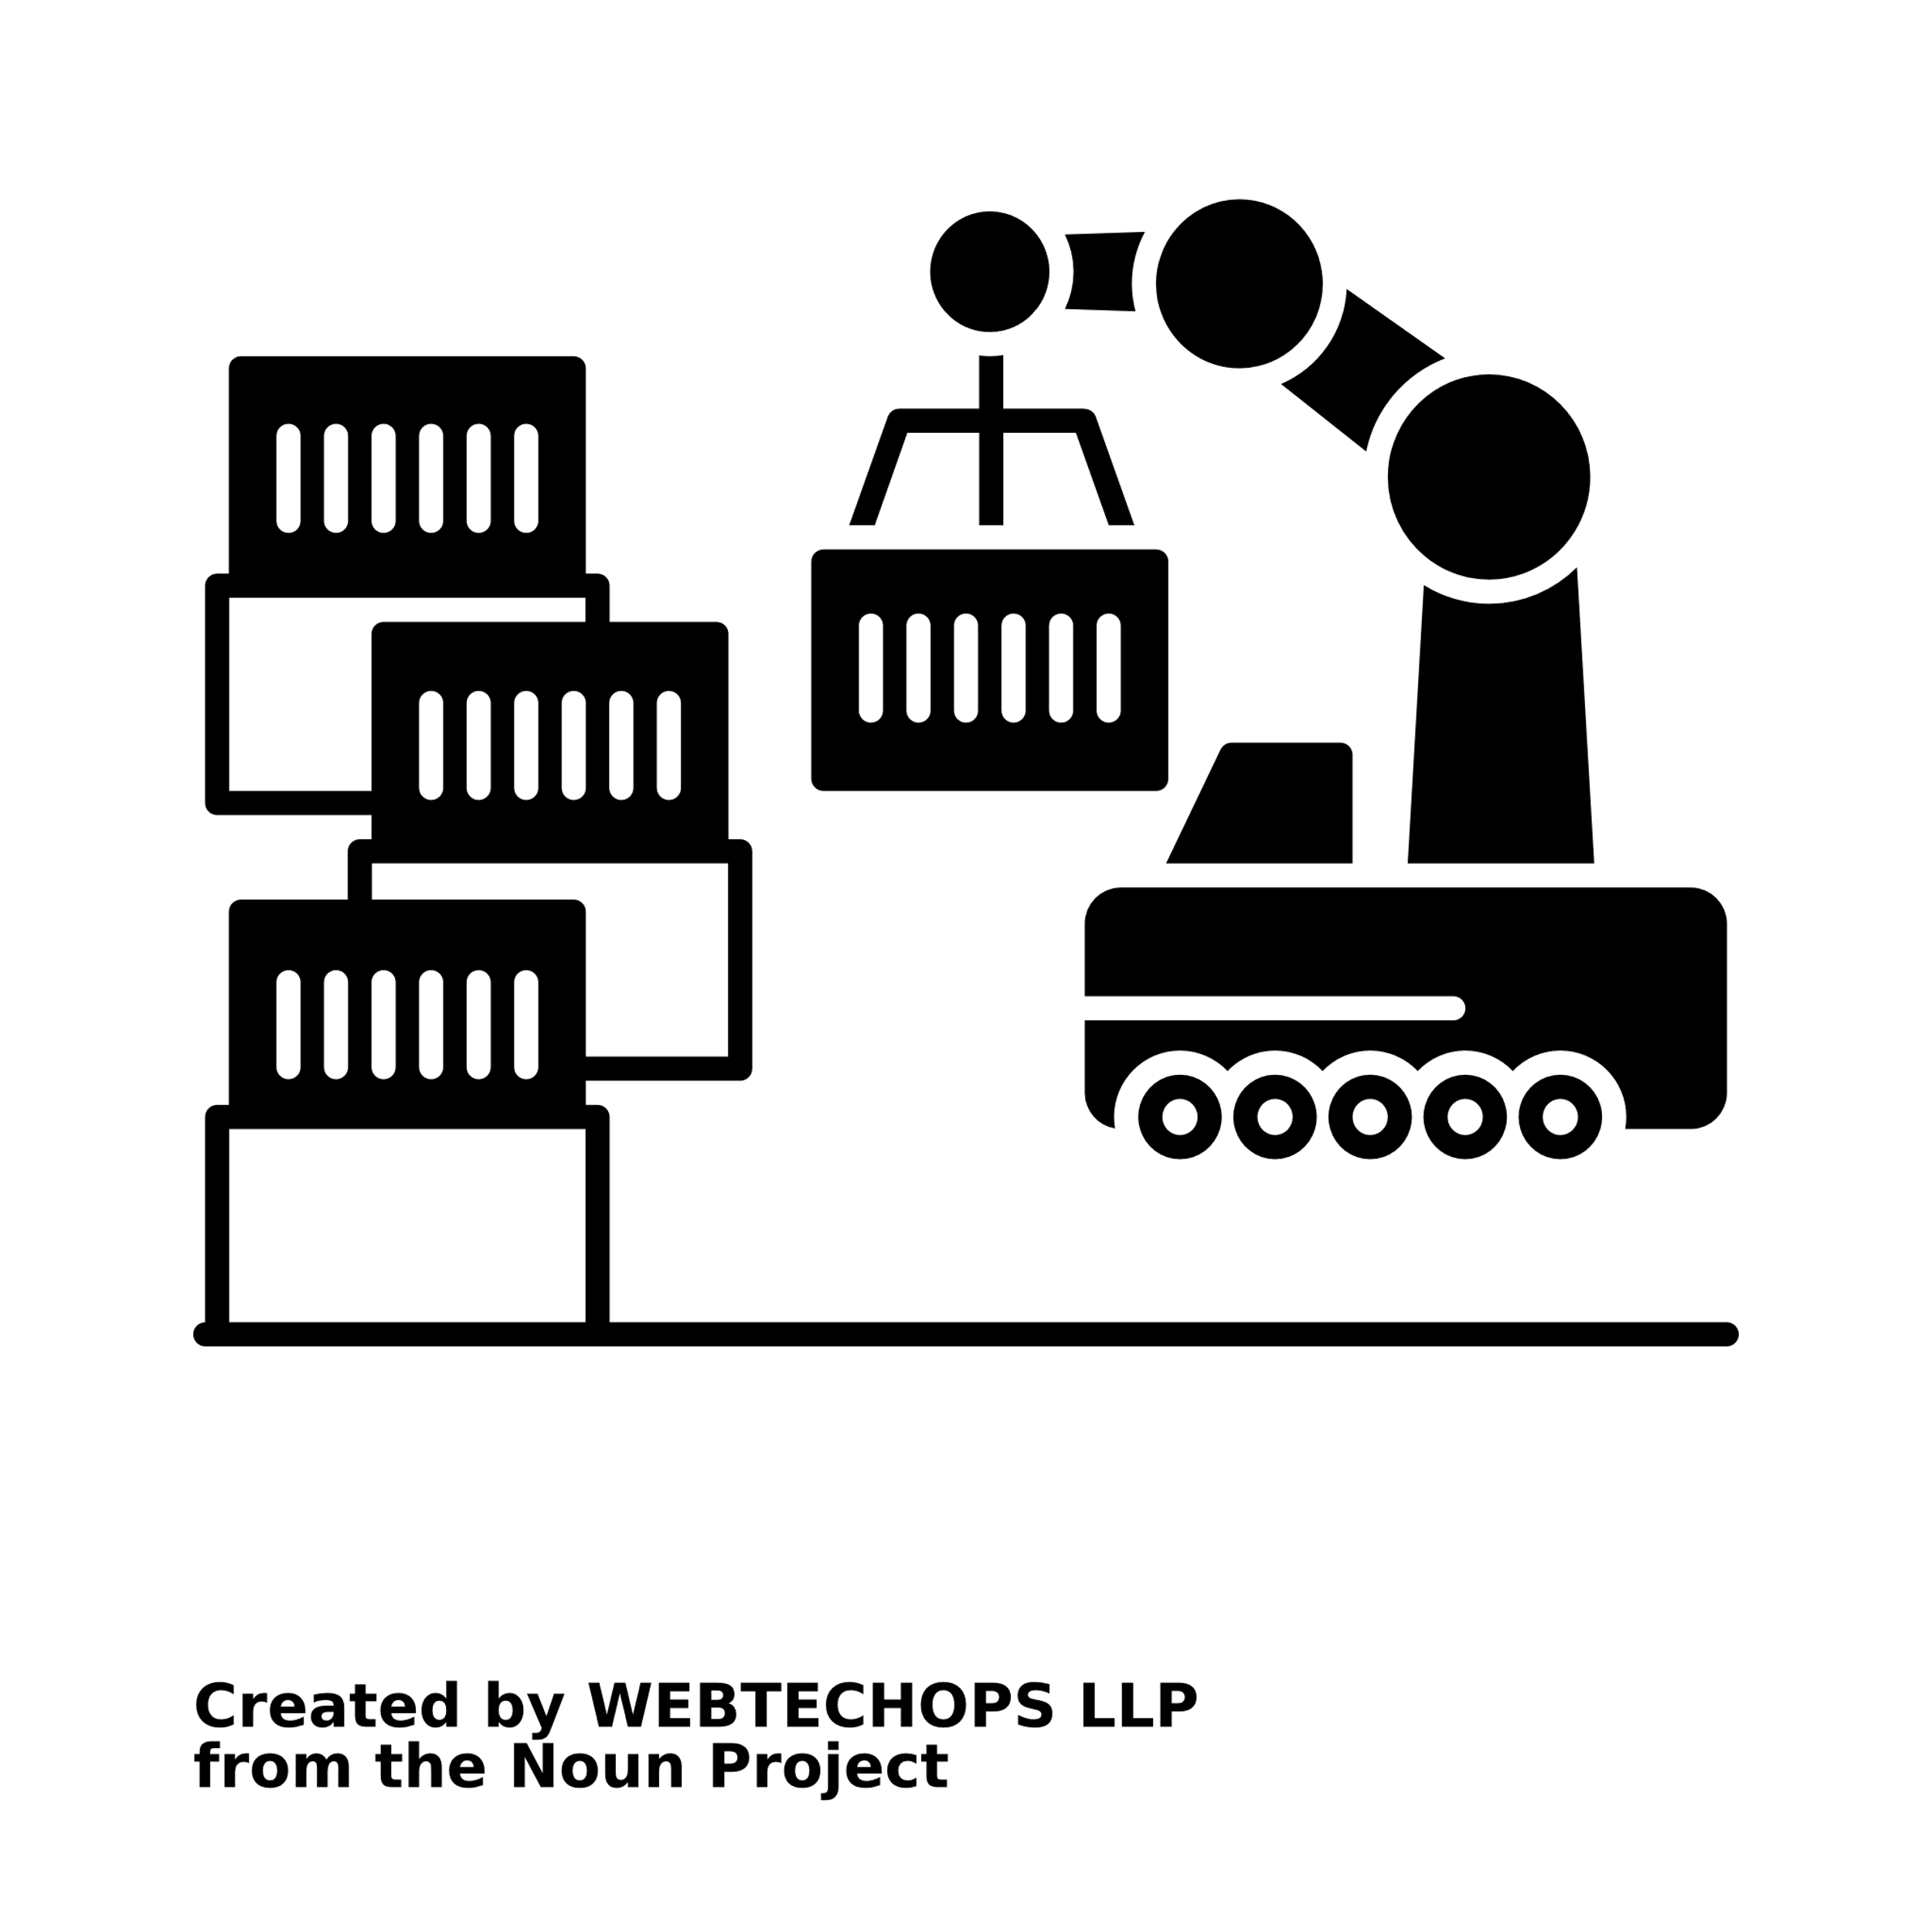

Operating Plan
If you’re planning to start a manufacturing, fabrication, or production business you’ll need a business plan to do it. To help you get started, check out our library of sample plans to be sure you’re covering everything from sourcing your raw materials to budgeting for plant and equipment.
If you’re planning to start a manufacturing, fabrication, or production business you’ll need a business plan to do it. To help you get started, check out our library of sample plans to be sure you’re covering everything from sourcing your raw materials to budgeting for plant and equipment.

